Slide 1
19Z604 Embedded Systems
Dr.N.Arulanand,
Professor,
Dept of CSE,
PSG College of Technology

Slide 2
Real Time Operating Systems
REAL TIME OPERATING SYSTEMS: Real-Time Concepts - Task Management - Task Scheduling - Classification of Scheduling Algorithms - Clock Driven Scheduling - Event Driven Scheduling - Resource Sharing - Priority Inheritance Protocol - Priority Ceiling Protocol - Commercial RTOS – VxWorks

Slide 3
VxWorks Tasks
It is often essential to organize applications into independent, though cooperating, programs. Each of these programs, while executing, is called a task.
Multitasking provides the fundamental mechanism for an application to control and react to multiple, discrete real-world events.
The VxWorks real-time kernel,wind, provides the basic multitasking environment.
On a context switch, a task’s context is saved in the task control block (TCB)

Slide 4
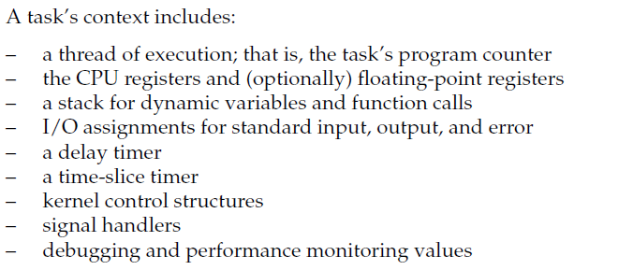
VxWorks Task
In VxWorks, one important resource that is not part of a task’s context is memoryaddress space: all code executes in a single common address space.

Slide 5
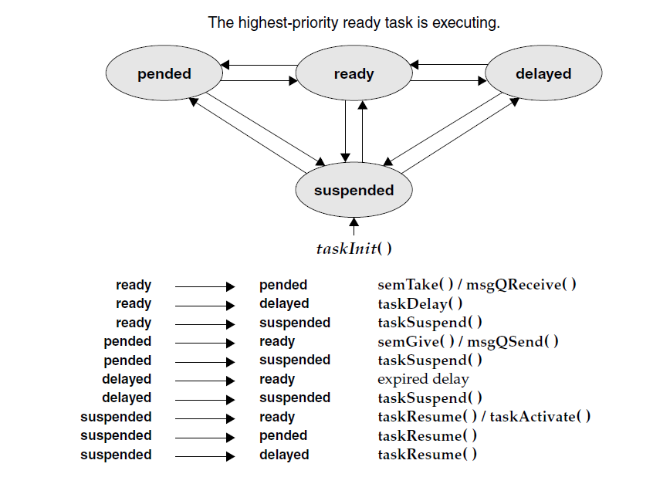
VxWorks – Task State Transition
The kernel maintains the current state of each task in the system.

Slide 6
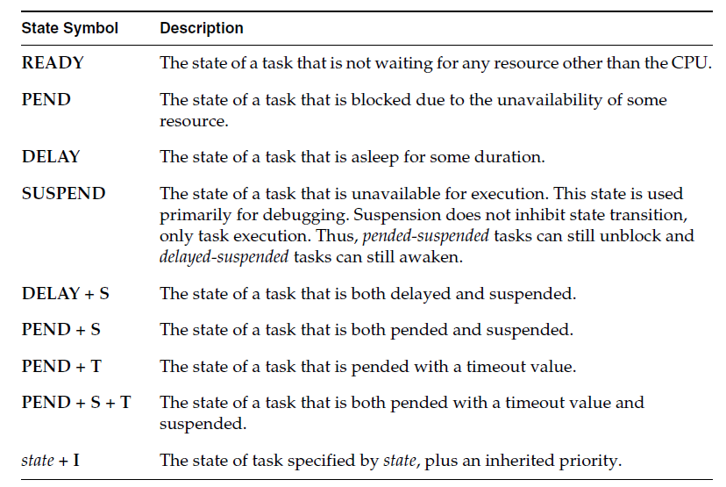
VxWorks – Task State Transition

Slide 7
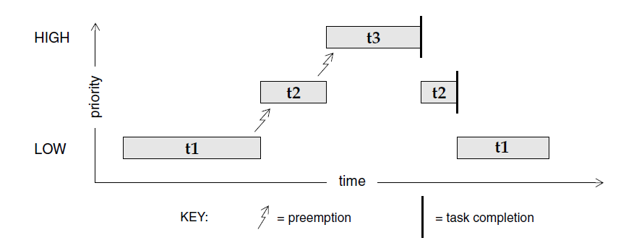
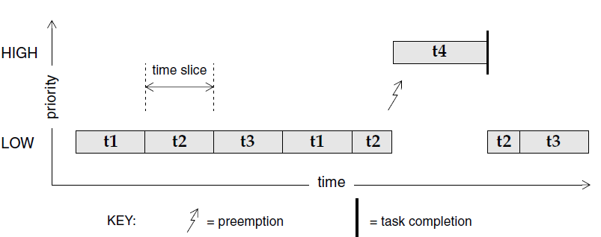
Scheduling algorithms
Preemptive Priority Scheduling
Round Robin Scheduling

Slide 8
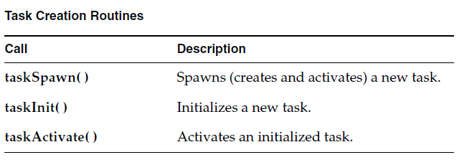
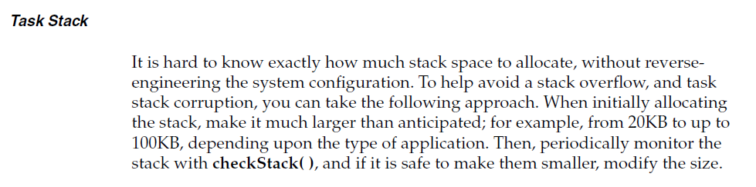
Task Creation routines

Slide 9
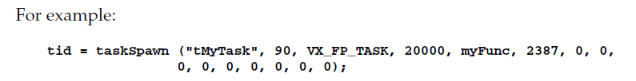
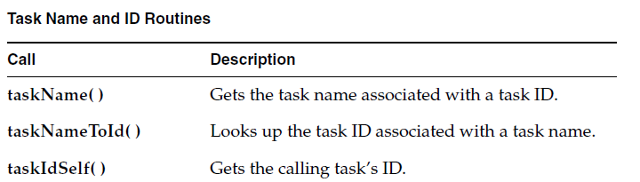
Task Name and routines

Slide 10
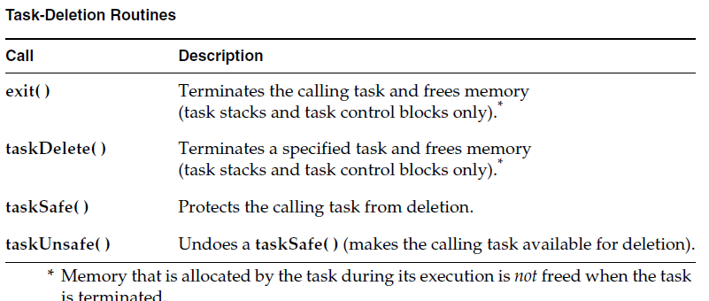
Task Deletion and Task Safety

Slide 11
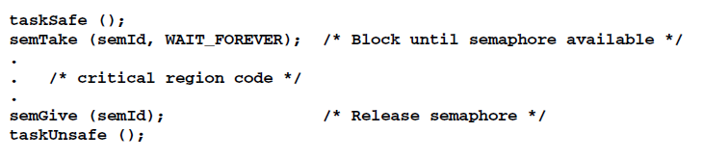
Task Safety
For example, a task might take a semaphore for exclusive access to some data
structure. While executing inside the critical region, the task might be deleted by
another task. Because the task is unable to complete the critical region, the data
structure might be left in a corrupt or inconsistent state.
taskSafe( ) to protect the task that took the semaphore prevents such an
outcome. Any task that tries to delete a task protected with taskSafe( ) is blocked. When finished with its critical resource, the protected task can make itself available for deletion by calling taskUnsafe( ), which readies any deleting task

Slide 12
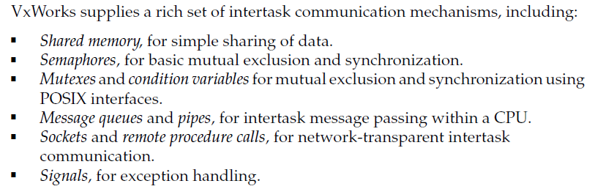
Inter Task Communication

Slide 13
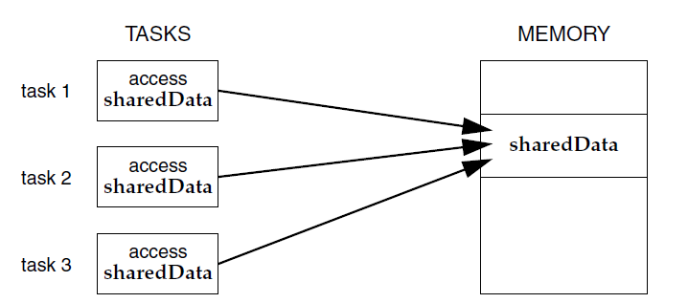
Shared Memory
Because all tasks in VxWorks exist in a single linear address space,
sharing data structures between tasks is trivial.
Global variables, linear buffers, ring buffers, linked lists, and pointers can be referenced directly by code running in different contexts

Slide 14

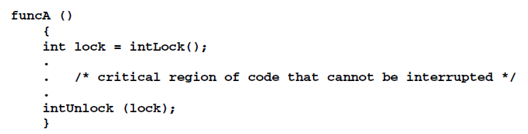
Mutual Exclusion
The most powerful method available for mutual exclusion is the disabling of
interrupts. Such a lock guarantees exclusive access to the CPU
While this solves problems involving mutual exclusion with ISRs, it is
inappropriate as a general-purpose mutual-exclusion method for most real-time systems, because it prevents the system from responding to external events for the duration of these locks. Interrupt latency is unacceptable whenever an immediate response to an external event is required

Slide 15
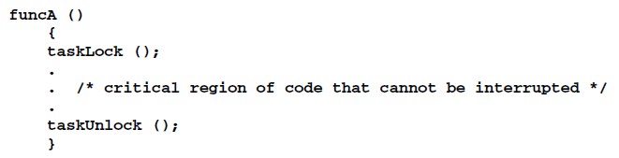
Mutual Exclusion
Allows interrupts…..
However, this method can lead to unacceptable real-time response. Tasks of higher priority are unable to execute until the locking task leaves the critical region, even though the higher-priority task is not itself involved with the critical region. While this kind of mutual exclusion is simple, if you use it, make sure to keep the duration short.

Slide 16
Semaphores
Semaphores are the primary means for addressing the requirements of both mutual exclusion and task synchronization:
For mutual exclusion semaphores interlock access to shared resources. They
provide mutual exclusion with finer granularity than either interrupt
disabling or preemptive locks
For synchronization semaphores coordinate a task’s execution with external
events.

Slide 17
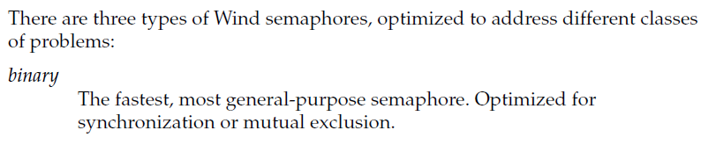
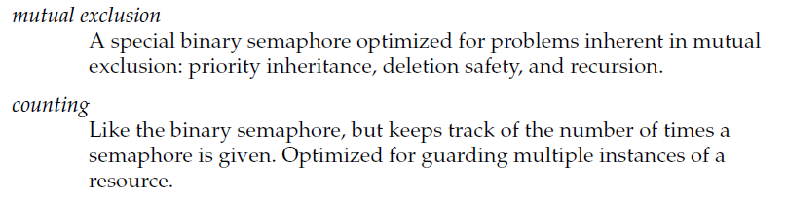
Semaphore Types

Slide 18
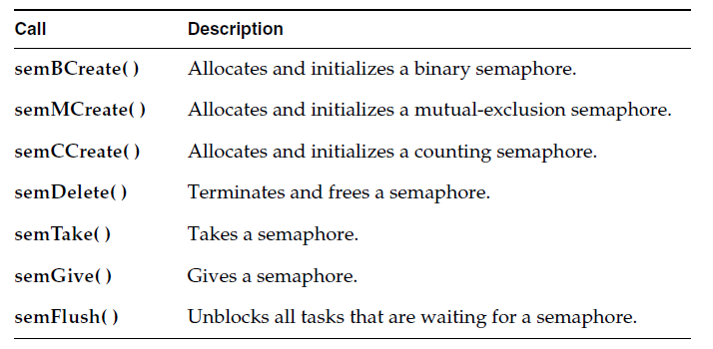
Semphore Control Routines
When a semaphore is created, the queue type is specified. Tasks pending on a semaphore can be queued in priority order (SEM_Q_PRIORITY) or in first-in first-out order (SEM_Q_FIFO).

Slide 19
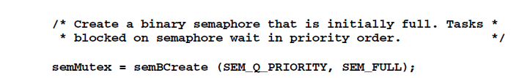
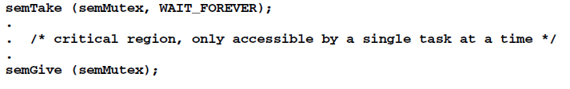
Binary Semaphore – Mutual Exclusion
When a task wants to access the resource, it must first take that semaphore. As long as the task keeps the semaphore, all other tasks seeking access to the resource are blocked from execution. When the task is finished with the resource, it gives back the semaphore

Slide 20
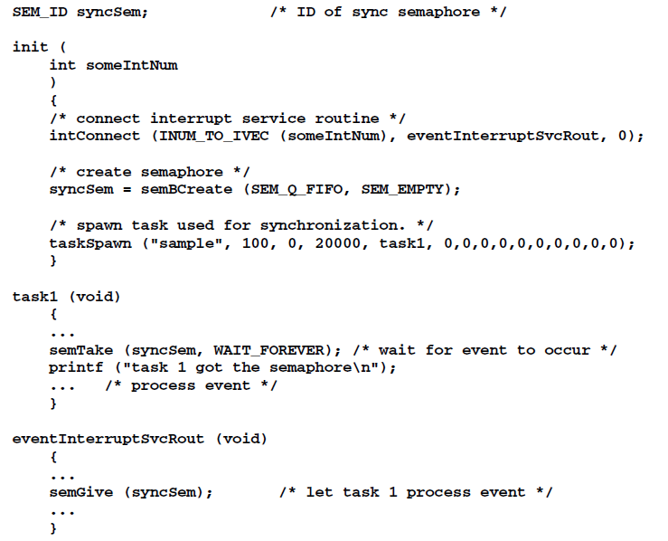
Binary Semphore - Synchronization

Slide 21
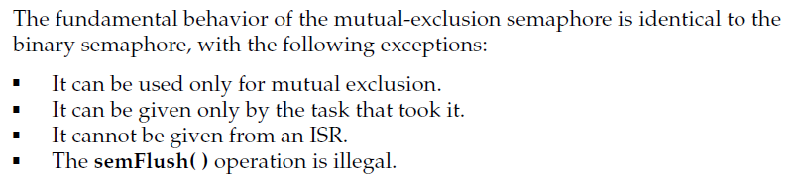
Mutual Exclusion Semaphore

Slide 22
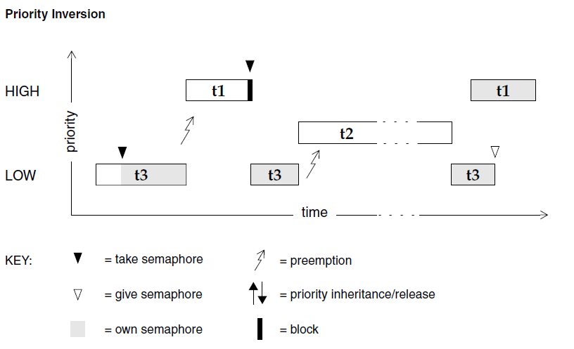
Mutual Exclusion Semaphore
The mutual-exclusion semaphore has the option SEM_INVERSION_SAFE, which
enables a priority-inheritance algorithm

Slide 23
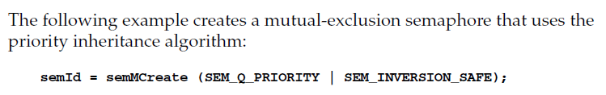

Mutual Exclusion Semaphore

Slide 24
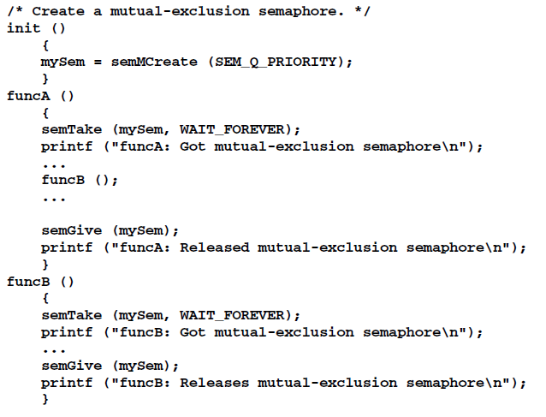
Recursive use of Mutex Semaphore

Slide 25
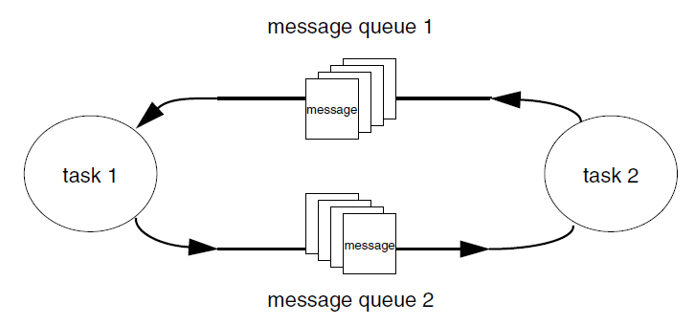
Message Queues

Slide 26
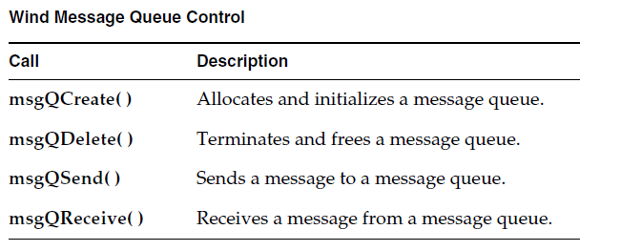
Message Queues
The value of the timeout parameter can have the special values of NO_WAIT (0), meaning always return immediately, or
WAIT_FOREVER (-1), meaning never time out the routine
The msgQSend( ) function allows specification of the priority of the message as either
normal (MSG_PRI_NORMAL) or urgent (MSG_PRI_URGENT)

Slide 27
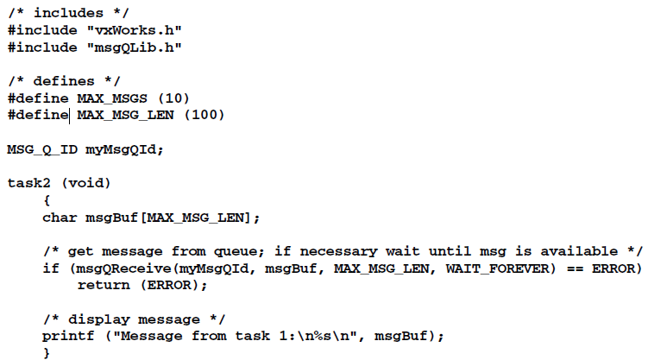
Message Queues

Slide 28
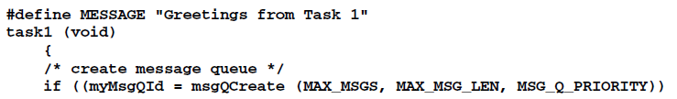
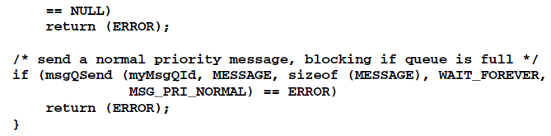
Message Queues

Slide 29
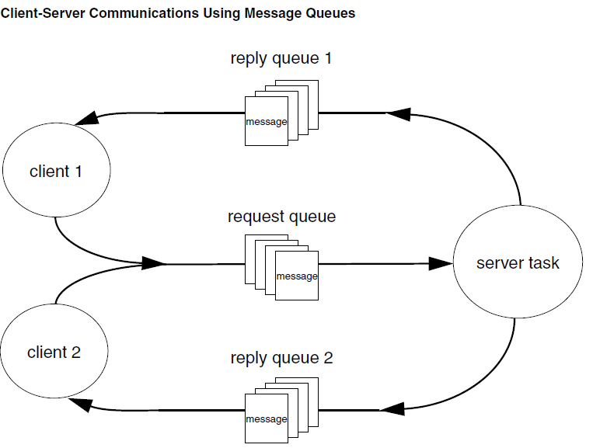
Message Queues

Slide 30
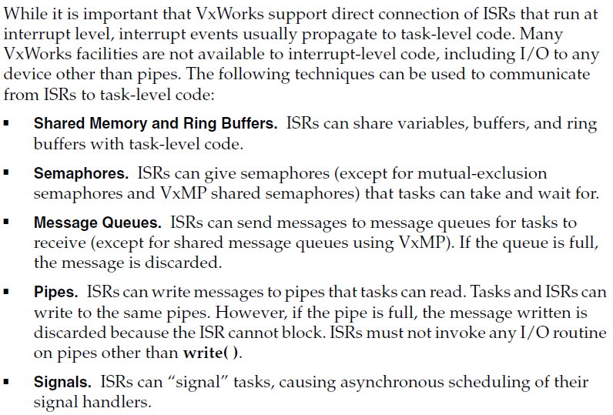
Interrupt to Task Communication

Slide 31
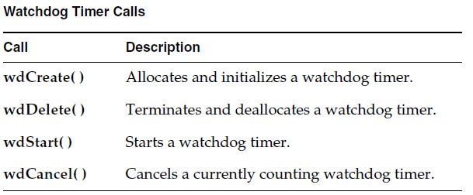
Watchdog Timer
A watchdog timer is first created by calling wdCreate( ).
Then the timer can be started by calling wdStart( ), which takes as arguments the number of ticks to delay, the C function to call, and an argument to be passed to that function.
After the specified number of ticks have elapsed, the function is called with the specified argument.
The watchdog timer can be canceled any time before the delay has elapsed by calling wdCancel( )

Slide 32
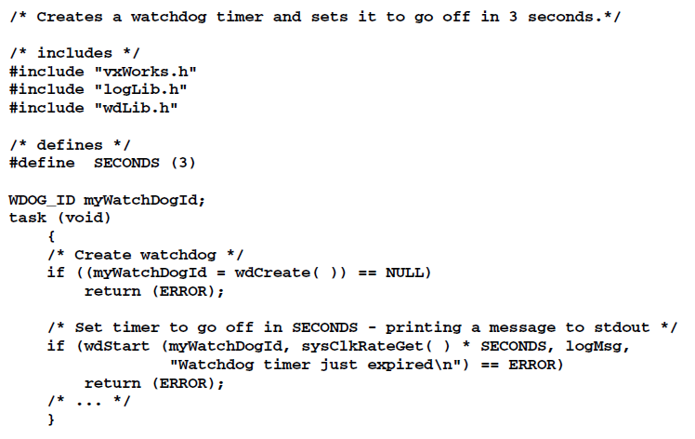
Watchdog Timer

Slide 33
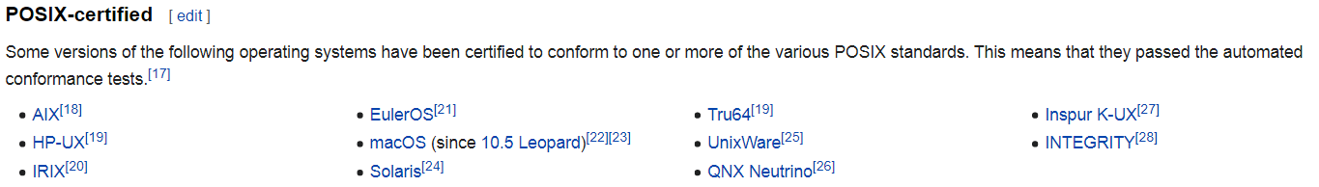
Portable Operating System Interface (POSIX)
The Portable Operating System Interface (POSIX) is a family of standards specified by the IEEE Computer Society for maintaining compatibility between operating systems. POSIX defines the application programming interface (API), along with command line shells and utility interfaces, for software compatibility with variants of Unix and other operating systems

Slide 34
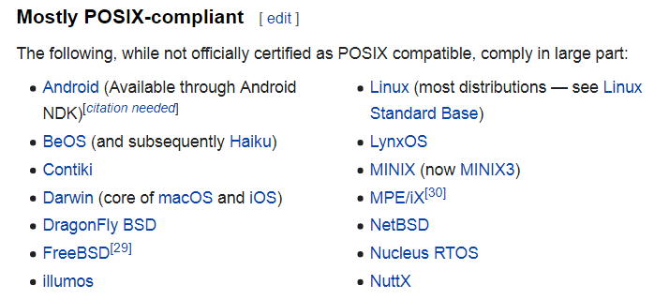
POSIX-compliant
POSIX for Microsoft Windows
Cygwin provides a largely POSIX-compliant development and run-time environment for Microsoft Windows.

Slide 35
POSIX for real time
The POSIX standard for real-time extensions (1003.1b) specifies a set of interfaces to kernel facilities.
To improve application portability, the VxWorks kernel, wind, includes both POSIX interfaces and interfaces designed specifically for VxWorks

Slide 36
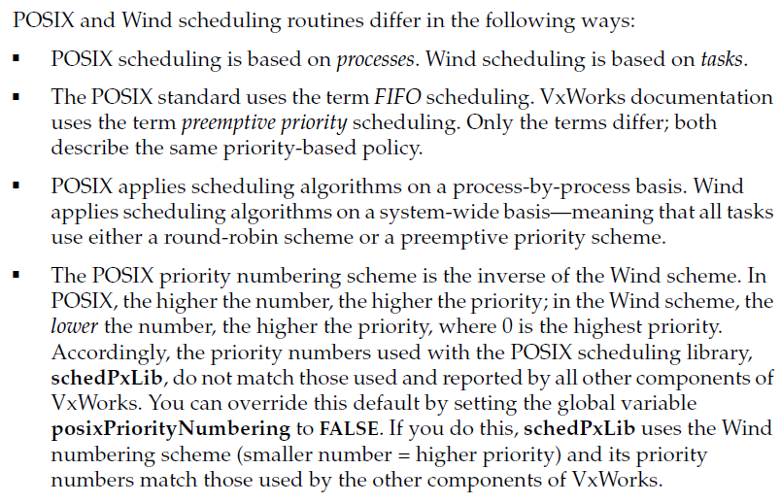
Comparison of POSIX and Wind Scheduling

Slide 37
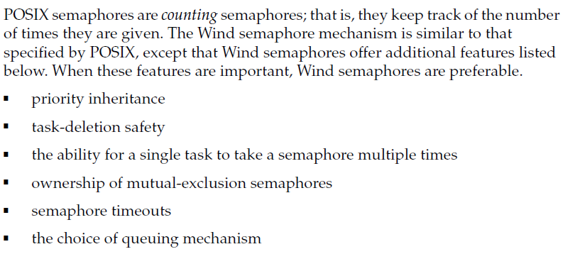
Comparison of POSIX and wind Semaphore

Slide 38
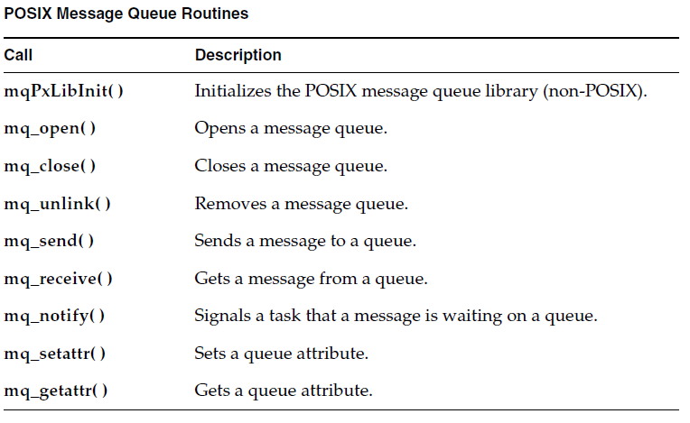
POSIX Message Queues

Slide 39
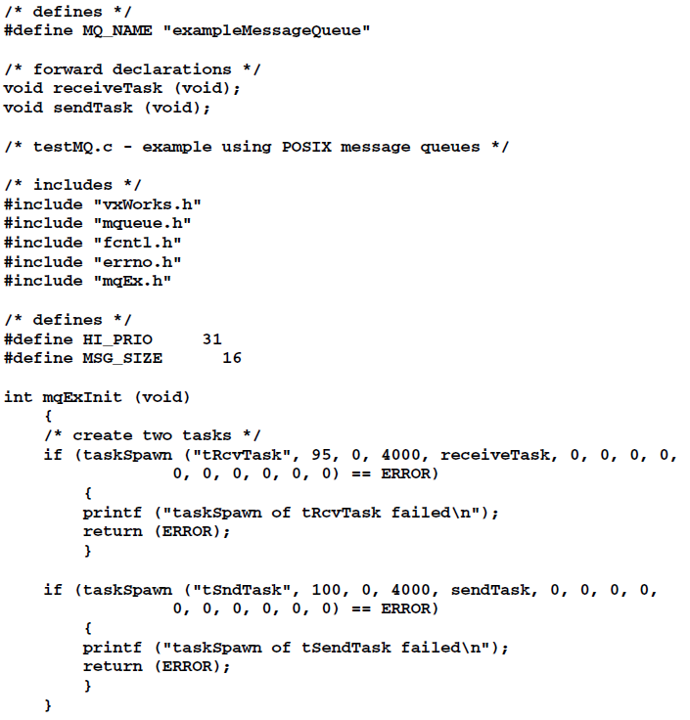
POSIX Message Queue - Example

Slide 40
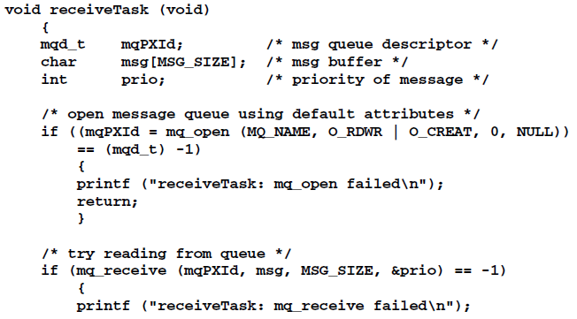
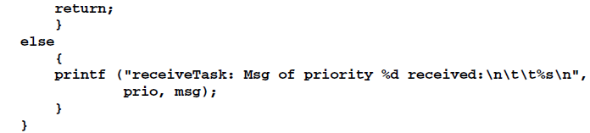

Slide 41
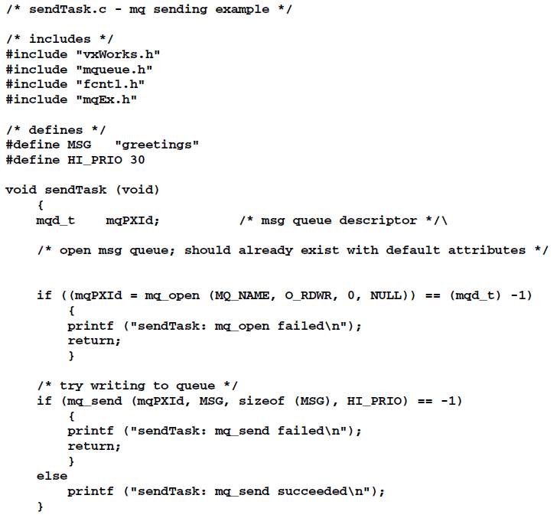

Slide 42
Thank You

